Slide 1


Python and Matplotlib

Slide 2
Matplotlib
A comprehension library for creating static, animated and interactive visualizations in Python.
Makes easy things easier and hard things possible.
Create publication quality plots
Make interactive figures that can zoom, pan and update.
Customize visual style and layout
Export to many file formats
Embed in JupyterLab and Graphical User Interfaces
Use a rich array of third-party packages built on it.

Slide 3
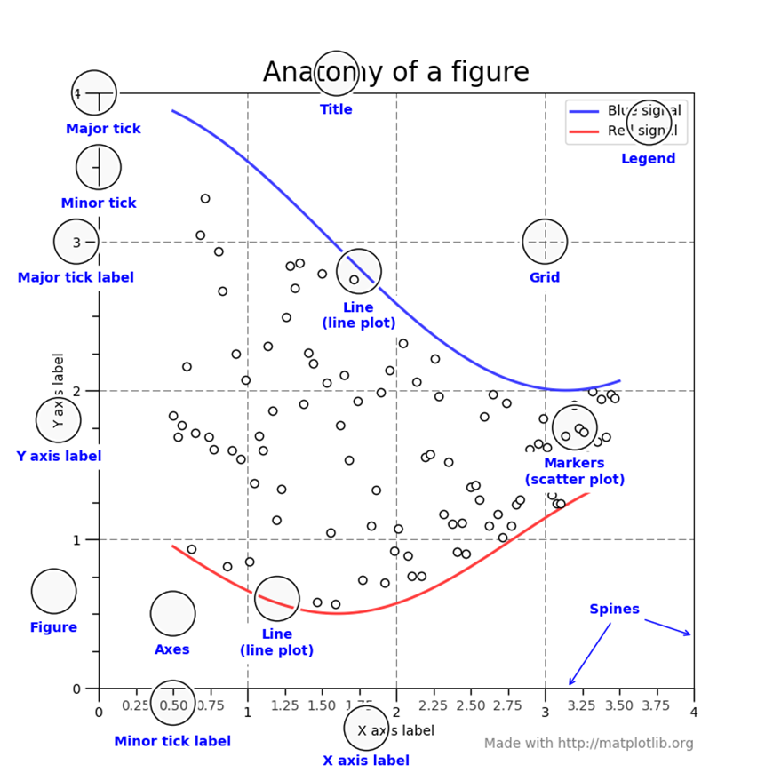

Slide 4
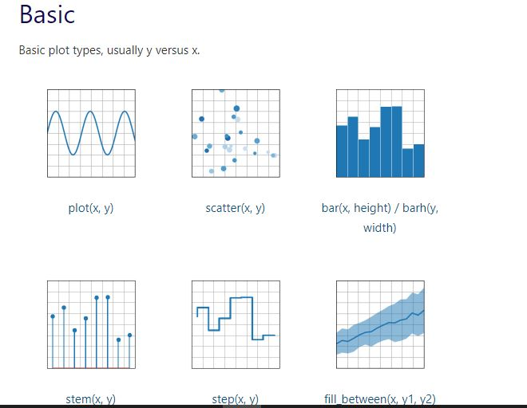
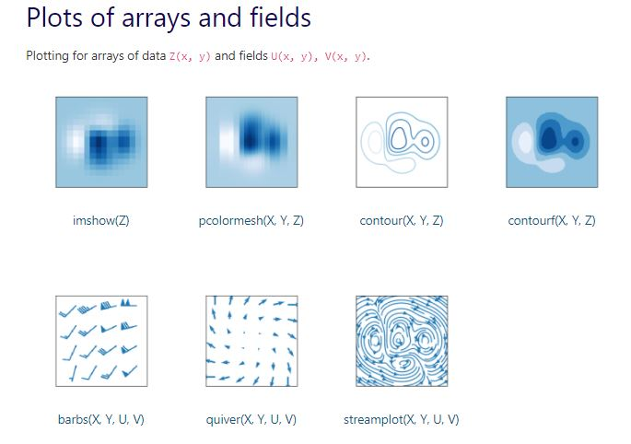
Types of Visuals

Slide 5
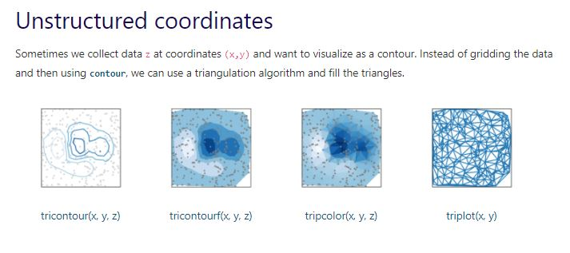
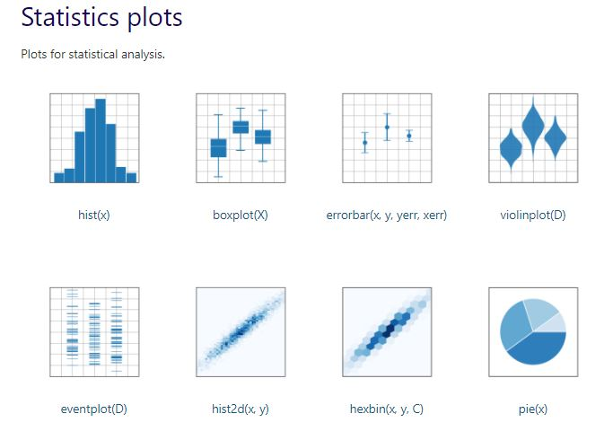

Slide 6
ALSO – pip install jupyter notebook
You need to install it
You need to import it
In your terminal, type
pip install matplotlib
import matplotlib.pyplot as plt
import numpy as np

Slide 7
Open VSCode make sure you are in the right directory initialize jupyter notebook

Slide 8
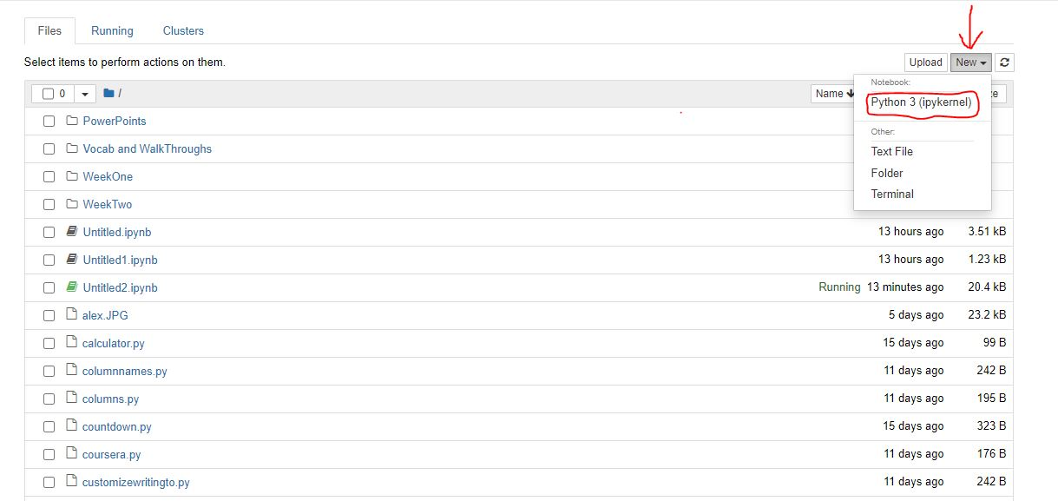
How to start the Jupyter Notebook Server
Type in jupyter notebook in your terminal and press enter

Slide 9
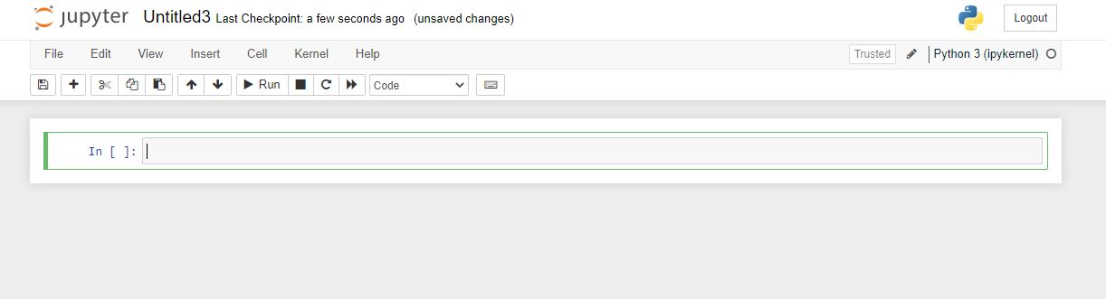
To execute commands click the RUN icon

Slide 10
Draw a line in a diagram from position (1, 3) to position (8,10)
import matplotlib.pyplot as plt
import numpy as np
xpoints = np.array([1, 8])
ypoints = np.array([3,10])
plt.plot(xpoints, ypoints)
plt.show()

Slide 11
Draw 2 points in a diagram from position (1, 3) to position (8,10)
import matplotlib.pyplot as plt
import numpy as np
xpoints = np.array([1, 8])
ypoints = np.array([3,10])
plt.plot(xpoints, ypoints, ‘o’)
plt.show()

Slide 12
Draw a line in a diagram from position (1, 3) to (2, 8) then to (6, 1) and finally to position (8,10)
import matplotlib.pyplot as plt
import numpy as np
xpoints = np.array([1, 8])
ypoints = np.array([3,10])
plt.plot(xpoints, ypoints, ‘o’)
plt.show()

Slide 13
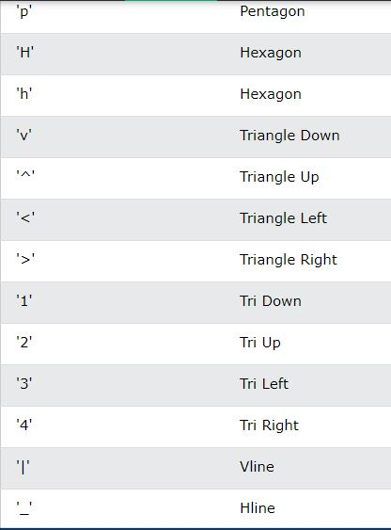
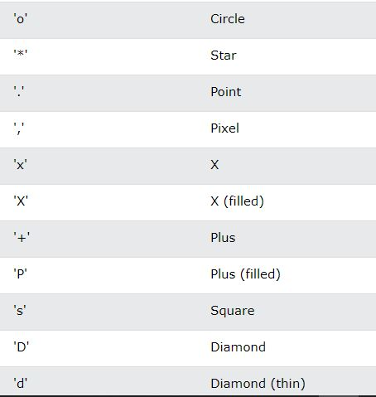
Customize – Customize - Customize

Slide 14
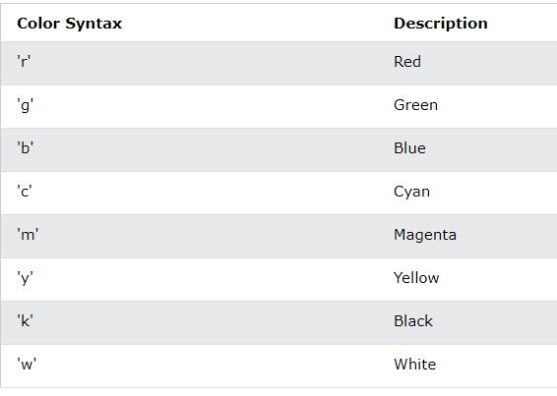

Slide 15
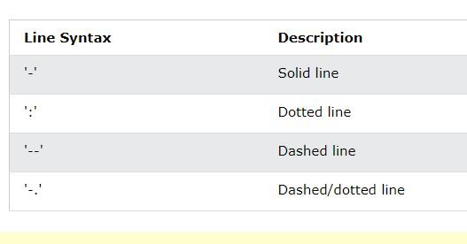

Slide 16
ms = markersize
mec = marker edge color
mfc = marker face color

